Slide 1
Introducing covid-19 pooled testing in school
INSERT DISTRICT NAME AND CONTACT INFO

Slide 2
Tonight’s Objectives
Explain new pooled testing program
Share how to sign up
Answer questions

Slide 3
Why pooled testing in schools
Notes:
10:15am

Slide 4
How Pooled Testing works in Schools

Slide 5
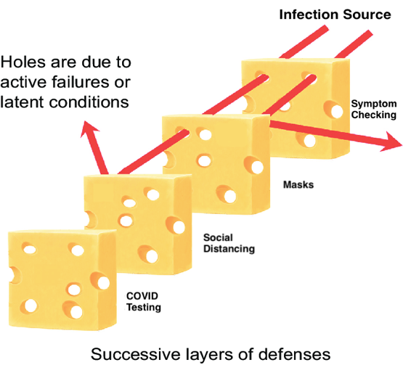
Testing is one more layer of protection

Slide 6
Testing is Just One Piece of the COVID-19 Safety Puzzle
We will continue to:
Require masks to be worn at all times (except lunch and masks breaks)
Maintain [INSERT] ft of distance between students
Ensure high quality ventilation
Require regular handwashing
Contact trace any positive case

Slide 7
Why Pooled Testing
Increases safety: primary benefit is to identify cases, including asymptomatic cases
Builds confidence and trust in safety of school buildings, staff, and students.
Understand Coronavirus incidence in schools/town on an ongoing basis
Encourage importance of safety measures among families out of school
Prepare for and perhaps accelerate return to in person schooling, enhancing the education of our kids

Slide 8
Testing is Voluntary & Free to Families
The Massachusetts Department of Elementary and Secondary education is paying for districts to launch testing for the first six weeks
After the first 6 weeks, we will be using other federal relief funds/fundraising from ____ to pay for testing until it is no longer needed.
COVID-19 testing works best when more students sign up!

Slide 10
Use this slide or the next one depending on if you are doing in-lab or on-site pooling

Slide 11
Use this slide or the next one depending on if you are doing in-lab or on-site pooling

Slide 12
It’s Painless, & Most Students Can Self-Swab
Notes:
What is classroom pooling?
It’s a method that combines test samples from all individuals in one classroom/group/cohort into one tube that’s then tested.
How will pools be created?
Staff and students from the same building and cohort will be grouped together.
How are the samples collected?
Anterior nasal swab (short swab) - a swab of the front of the nostril.
can be self-administered by adults and older children (under supervision)
younger students can be administered by any trained school staff

Slide 13
How covid-19 testing in [insert school district] works

Slide 14
First, Sign the Consent Form to Opt your Student in to Testing
You only have to sign once for the entire program
By signing the consent form, you consent to:
Your student receiving a pooled test and, if needed, an individual follow-up test.
Your student’s information being transmitted via provided technology. All technology is secure and compliant with data privacy laws.
[INSERT DETAILS ABOUT YOUR CONSENT PROCESS]

Slide 15
Once Testing Starts:
On their assigned day, students will swab themselves or be swabbed (depending on their age). The swab will be placed into a pool test tube along with swabs from other students in the pooled group.
24-48 hours later – pooled testing results will come to the school.
If your student is in a pool that is negative, you will not hear anything
If your student is in a pool that is positive, your student will receive a follow-up test // that pool will be re-tested to identify which student is positive.

Slide 16
Follow-Up Testing
If your student is in a positive pool, they will be asked to take a follow-up test.
Here’s how it works:
WHEN: [INSERT TIME(S) FOR FOLLOW-UP TESTING]
WHERE: [INSERT LOCATION(S) FOR FOLLOW-UP TESTING]
For follow-up testing we use [INSERT FOLLOW-UP TEST PROCESS]
For help creating a follow-up testing plan, check out our Follow-Up Testing Guide at www.CovidEdTesting.com

Slide 17
Our Weekly Testing Schedule
Create your own testing logistics schedule using our template at www.CovidEdTesting.com

Slide 18
Questions?
INSERT CONTACT INFO

